Slide 1

Fraud Detection & Transaction Analytics
Data-Driven Analysis of Transactions and User Behavior
Ahmed Ashraf

Slide 2

CONTENT
1
2
User Insights & Transaction Patterns
Introduction & Dataset Overview
3
Fraud Analysis
4
Key Findings & Recommendations

Slide 3


01
Introduction & Dataset Overview

Slide 4
Introduction
Objective:
Analyze transaction and user data to uncover spending patterns and detect fraudulent activities.
Focus:
Combine user demographics, transaction behavior, and fraud patterns for actionable insights
Goal:
Enhance data-driven decision-making and strengthen trust in financial systems.

Slide 5

Dataset Structure Analysis
01
02
03
Data Volume and Sources
Key Data Fields
Data Quality Assessment
Overview of transaction dataset with 1.2M records, sourced from Kaggle, simulating data from banking systems, merchant networks, and fraud reporting platforms.
Transaction ID & Timestamp
Transaction Amount (+/- for refund)
Merchant City, State & Category (MCC)
Card Brand & Card Type
User Age, Gender, Income
Fraud Indicator (Yes/No)
Missing values in merchant state & zip (handled with imputation).
Outliers in user age (90+ years).
Negative amounts flagged as refunds.
Duplicate checks on transactions & user IDs.
Standardized money fields (removed $).

Slide 6
02
User Insights & Transaction Patterns

Slide 7
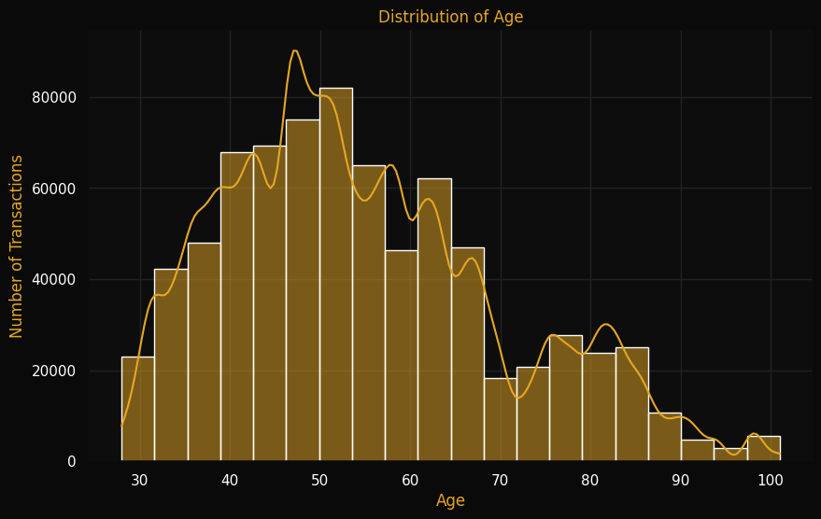
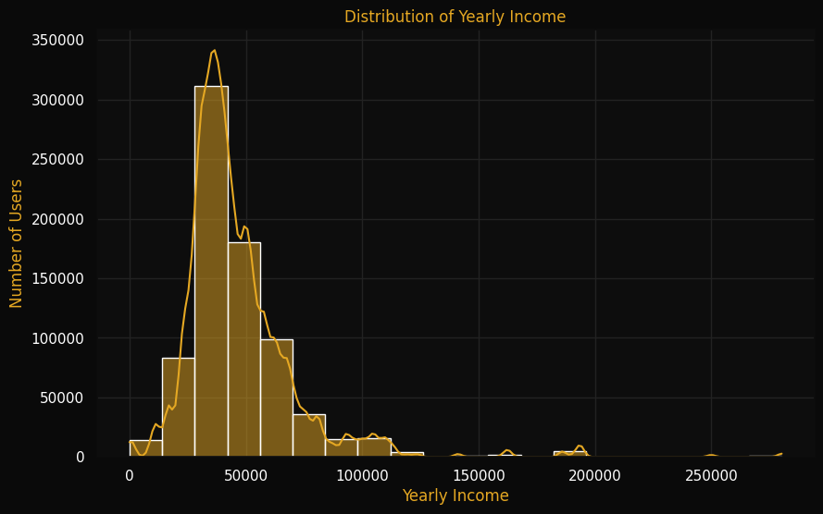
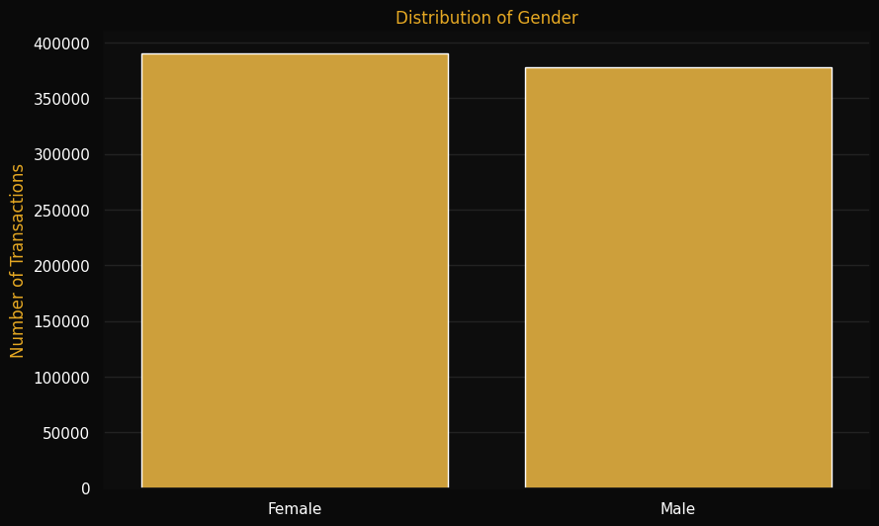
User Demographic Insights
01
02
03
Age Distribution Analysis
Income Level Insights
Gender Split Overview

Slide 8
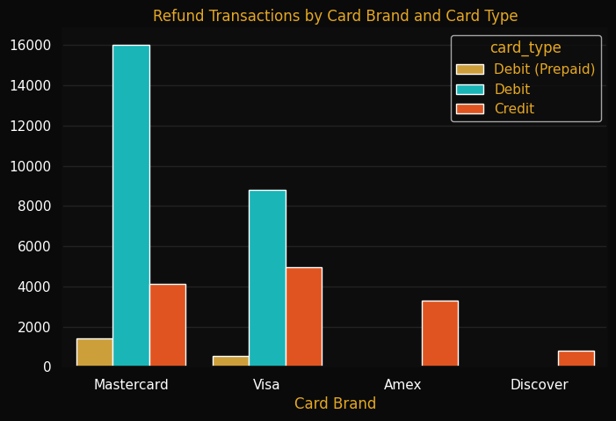
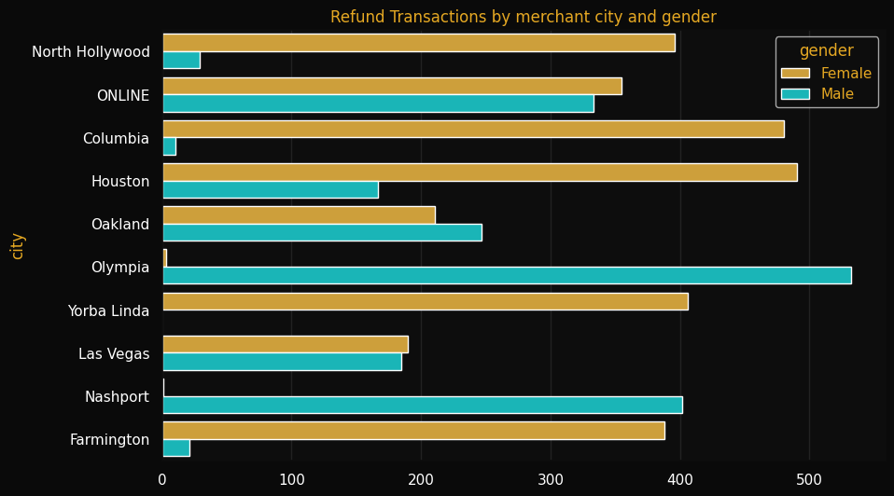
Refund Analysis by Card, Gender & City

Slide 9


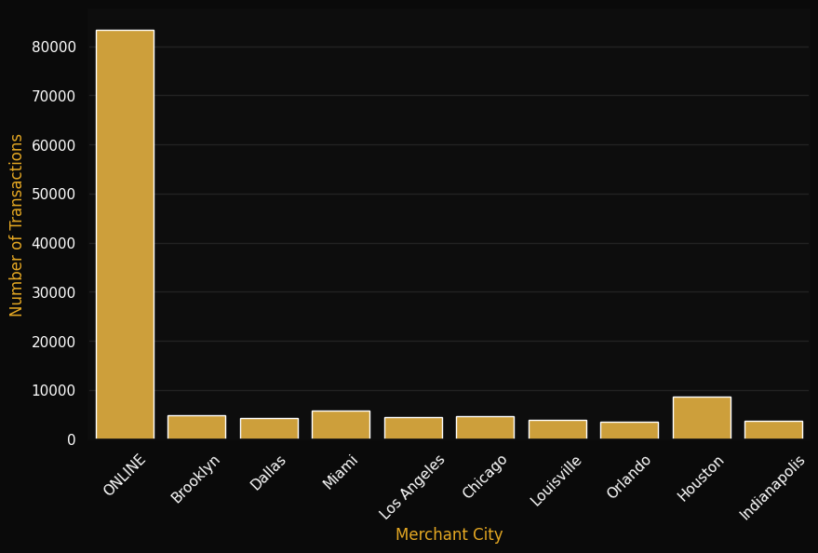
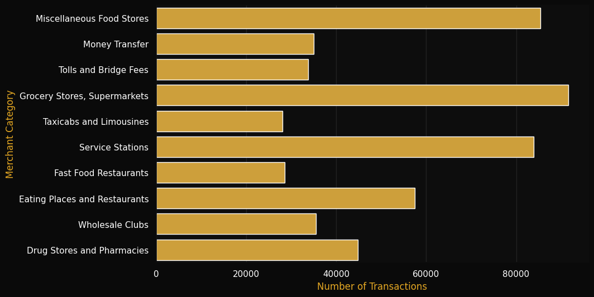
Transaction Distribution Patterns
1
2
Geographic Transaction Patterns
Merchant Category Analysis

Slide 10
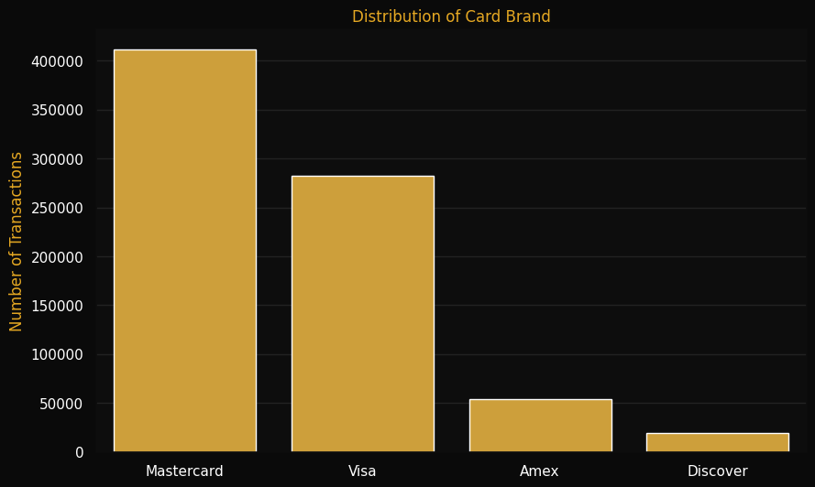
Card Brand Distribution

Slide 11
03
Fraud Detection Analysis

Slide 12
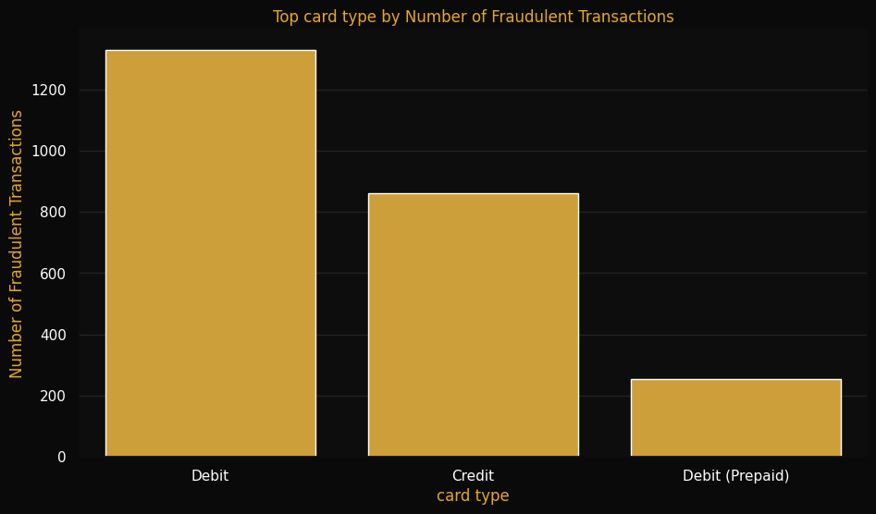
Fraud Patterns Across Card Types

Slide 13
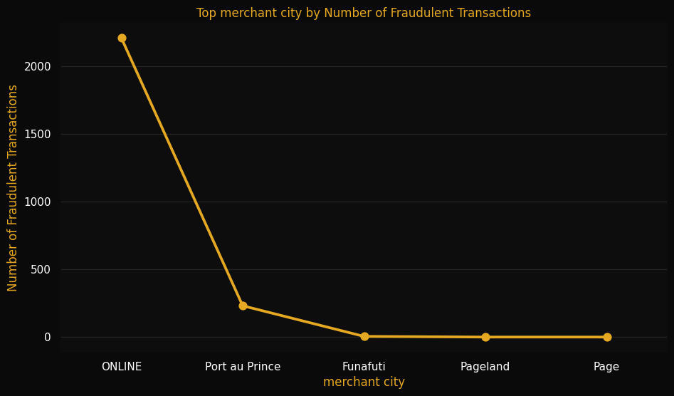
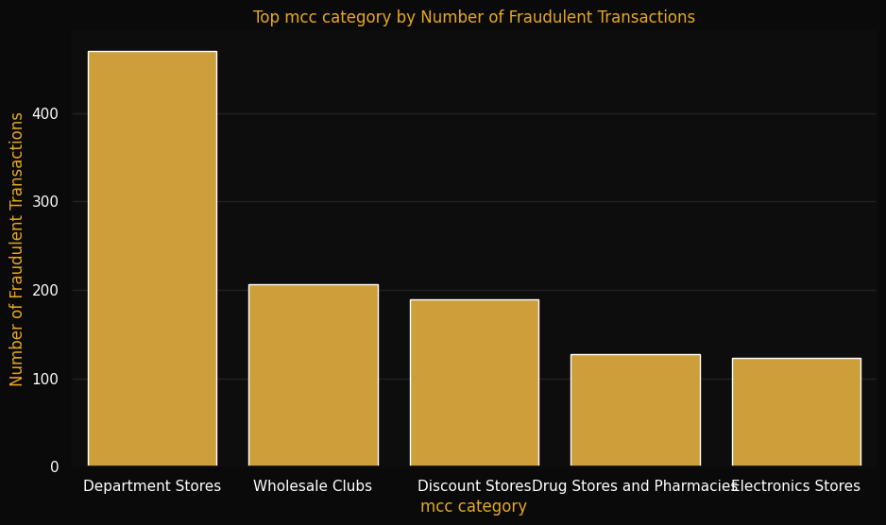
Geographic and Category-Wise Fraud Distribution
1
2
Merchant City
Merchant Category

Slide 14
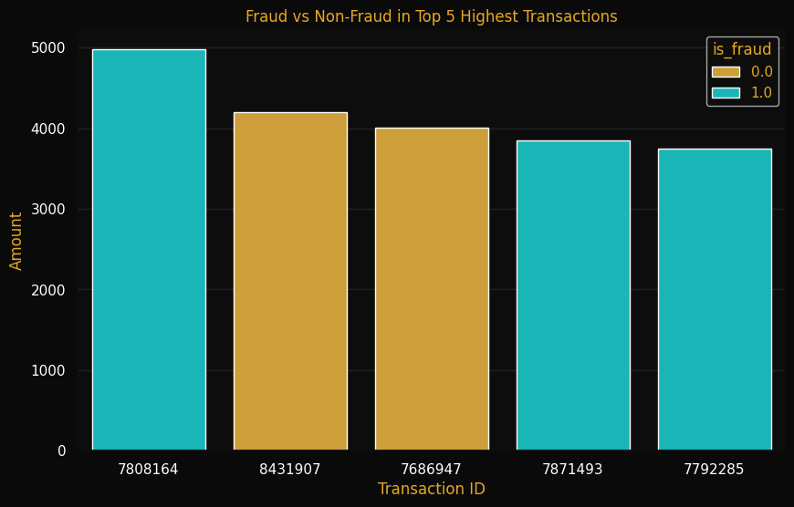
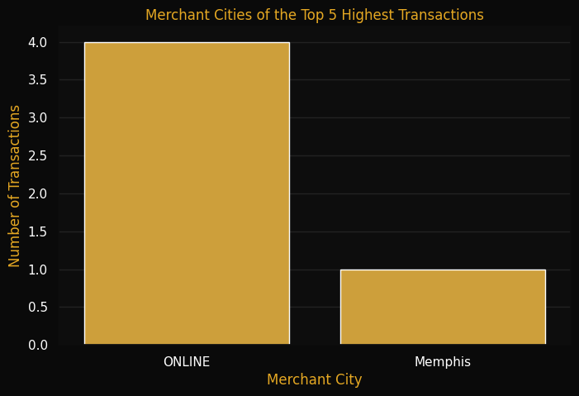
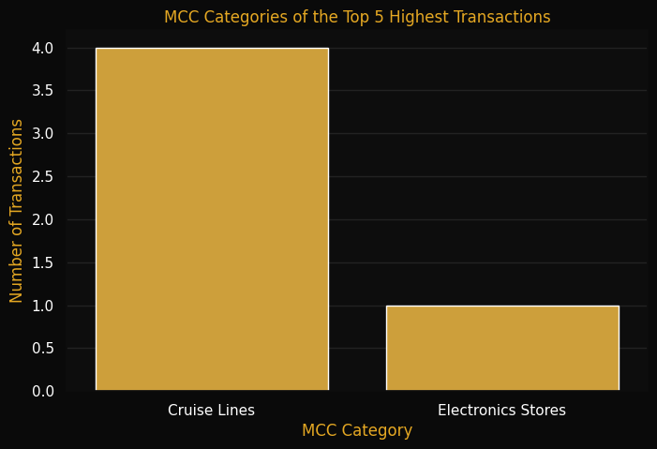
Fraud vs Non-Fraud in Top 5 Transactions
01
02
03
Top 5 Transactions
Merchant City
Merchant Category

Slide 15
04
Key Findings & Recommendations

Slide 16

Key Risk Indicators
Transaction Amount Thresholds
Geographic Hotspots
Unusual transaction amounts exceeding normal patterns often indicate potential fraud activity, requiring immediate investigation and verification protocols.
Transactions from high-risk locations show increased fraud probability, requiring enhanced monitoring and authentication measures.
Risky Merchant Categories
Suspicious Timing & Frequency
Certain merchant categories show higher fraud rates, particularly electronics, jewelry, and online services where verification is limited.
Unusual transaction timing or frequency patterns often signal account compromise, especially overnight or rapid successive purchases.

Slide 17

Prevention Strategies
Real-Time Monitoring
Adaptive Fraud Detection
Implement advanced monitoring tools that flag suspicious transactions instantly, allowing for immediate intervention before fraudulent transactions complete.
Deploy adaptive algorithms that learn from historical fraud patterns to predict and prevent future attempts with increasing accuracy over time.
Risk-Based Authentication
Customer Awareness
Require additional verification steps for high-risk transactions, significantly reducing unauthorized access while maintaining customer experience for legitimate users.
Develop targeted communications to inform customers about common fraud tactics and protective measures they can implement to safeguard their accounts.

Slide 18
Thanks！

